Slide 1
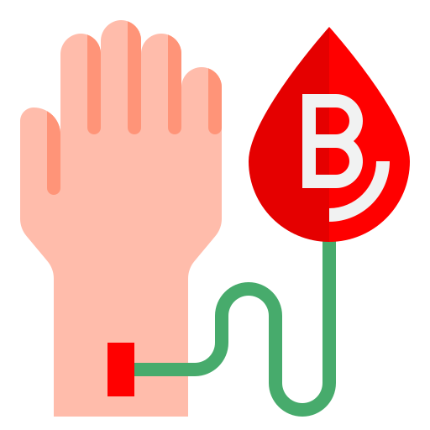
Android Blood Bank Application
“ Blood - Fuel That Runs Living Body “ood runs well “

Slide 2
Presented By:
Aasutosh Kumar Jha
Bharat KC
Kishor Bam
Uttam Joshi

Slide 3
Introduction
Android based blood management system.
Provides the platform to link blood donors and recipients.
Users need to get registered and authorized before they can use the services.
Contains the blood request list, donors list, contact number and some other user details too.

Slide 4
Why Blood Bank App?
To overcome the manual difficulties of searching the blood.
Helps in quick Response i.e minimizes communication gap between bloodseeker and blood donor.
Though many blood apps already exist in Nepal, they haven’t yet grouped many features together and they are not much reliable.
Requests and Donors are visible directly on map.

Slide 5
Feasibility
Technical Feasibility
Java Programming Knowledge
Knowledge of Firebase Technologies
Computer enough to run Android Studio
Economic Feasibility
Android Studio and Firebase Technologies are free.
Google maps API and Geocoder API are also free.
Operational Feasibility
Simple user interface.
Who can interact with Android Phone can easily use.

Slide 6
Tools Used
Android Studio
Java
Firebase Realtime Database
Firebase Authentication
Google Maps API
GeoCoder API

Slide 7
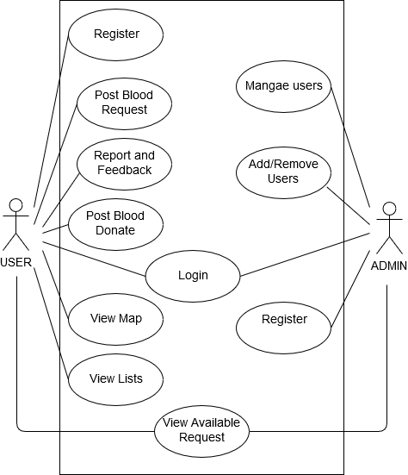
Use Case Diagram

Slide 8
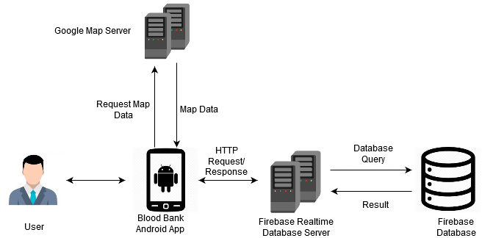
Architecture Design

Slide 9
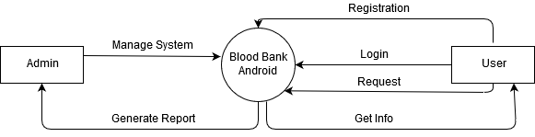
System Context Diagram

Slide 10
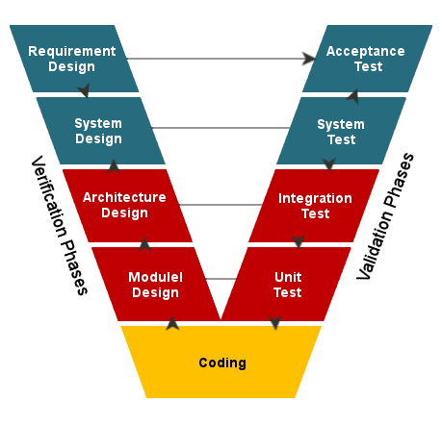
Development Methodology

Slide 11
Testing
Unit Testing
Each individual module is tested such as user registration and user login.
Integration Testing
Different individual modules are combinedly tested. Eg: login and check the request feed.
System Testing
The whole system working process is checked.

Slide 12
Limitation and Future Enhancement
Require Internet Access.
Require Android Device version above 5.0.
Fake post cannot be identified.
No real time tracking of users.
Event and Blood Request Notification.
Support for facebook Family and Friends circle.
Users being able to chat inside the application for communication purposes.

Slide 13
Conclusion
Users now can post blood requests and it will be shown in the request feed or on the map.
Other users can see the request in the feed or on the map and respond to it.
Users can able to see the database of users who are registered in the app, and can see if they are available for donation or not and contact them.
Users can contact the admins if they run into any problems.

Slide 14
Thank you!
Any Queries?

